Slide 1
12:10:14 PM
LECTURE 8

Slide 2
TEST OF HYPOTHESIS
Concepts of Sampling
Concepts of Hypothesis Testing:
-The Null and Alterative/Research Hypotheses
-One and two-tail tests
Testing involving the mean for a single population
-Large sample test-Z-test
-Small sample test- student -t

Slide 3
SAMPLING
Definition:
Sampling is a selection of a part of a population, called “sample”.
It is sometimes difficult or impossible to carry out research of an entire population
Examples
fish in a lake,
inhabitants in a city,
machines in various factories,
students’ performance in national examination, etc
therefore a section of a population is analyzed and conclusions made for the entire population.

Slide 4
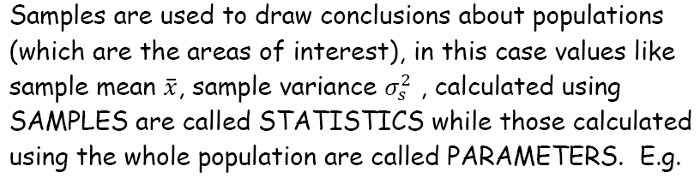
SAMPLING
Populations are too large to study in their entirety therefore it is necessary to select representative sample of manageable sizes.

Slide 5
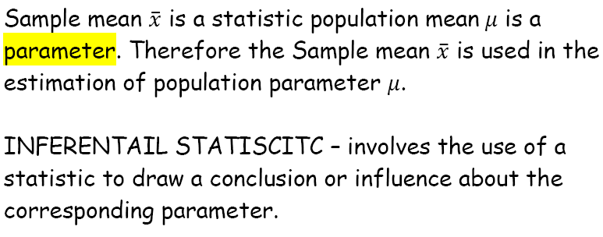
SAMPLING

Slide 6
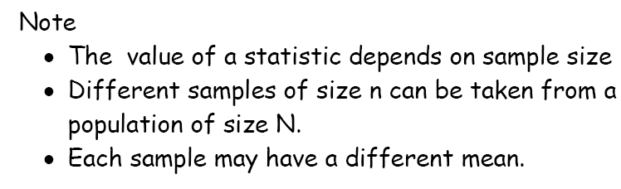
SAMPLING

Slide 7
TEST OF HYPOTHESIS
Definition:
A statistical hypothesis is an assumption (statement) about a population. The statement may be true or false . Calculation are done to prove it right or wrong . A hypotheses in formulated with a view to rejecting or accepting it.

Slide 8
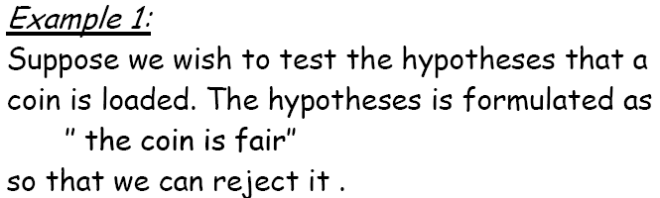
TEST OF HYPOTHESIS

Slide 9
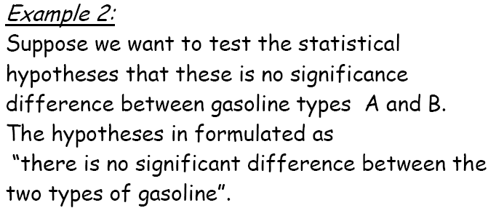
TEST OF HYPOTHESIS

Slide 10
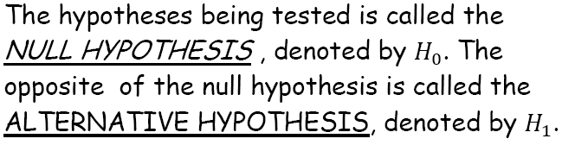
TEST OF HYPOTHESIS

Slide 11
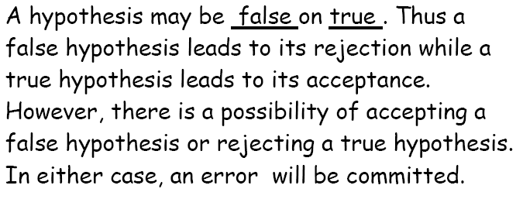
TEST OF HYPOTHESIS

Slide 12
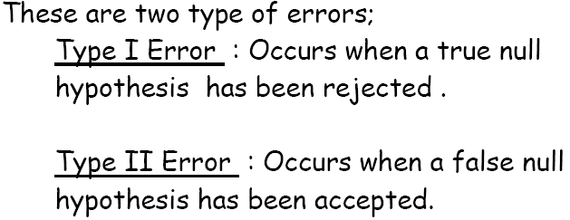
TEST OF HYPOTHESIS

Slide 13
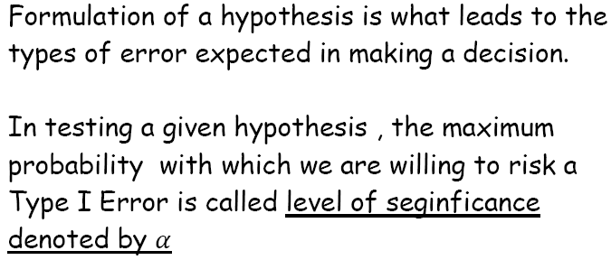
TEST OF HYPOTHESIS

Slide 14
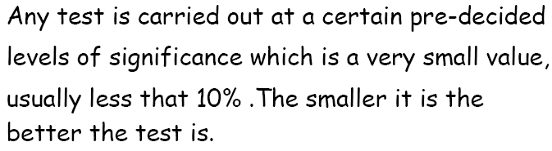
TEST OF HYPOTHESIS

Slide 15

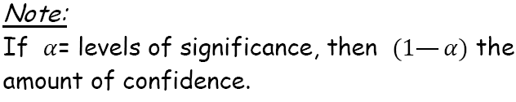

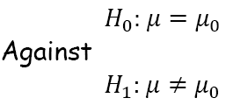

TEST OF HYPOTHESIS

Slide 16

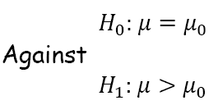

TEST OF HYPOTHESIS

Slide 17
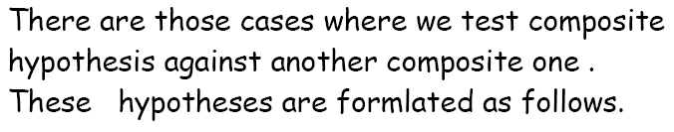
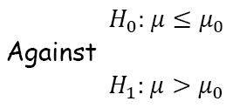
TEST OF HYPOTHESIS

Slide 18

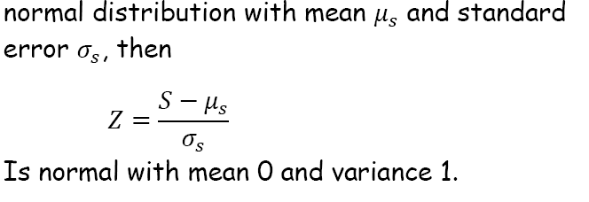
TEST OF HYPOTHESIS

Slide 19
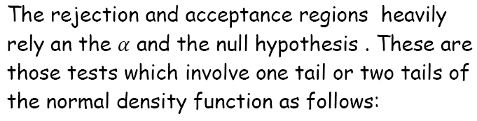

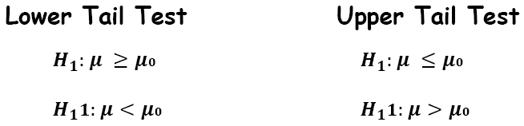
TEST OF HYPOTHESIS

Slide 20
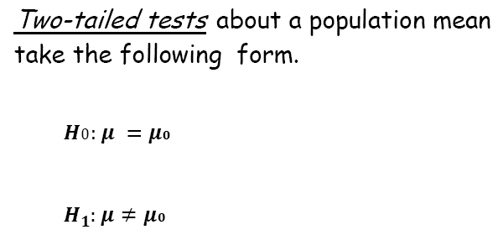
TEST OF HYPOTHESIS

Slide 21
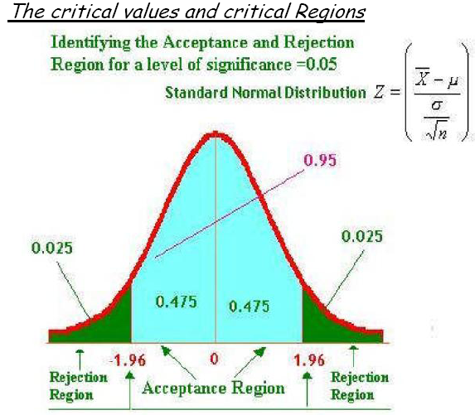
TEST OF HYPOTHESIS

Slide 22
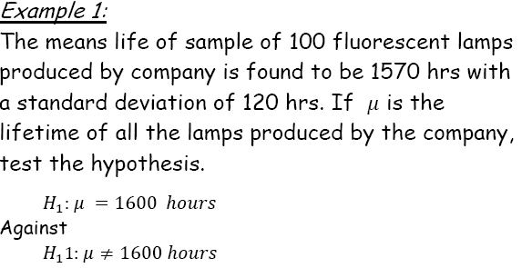


TEST OF HYPOTHESIS

Slide 23
TEST OF HYPOTHESIS
Solution ???

Slide 24
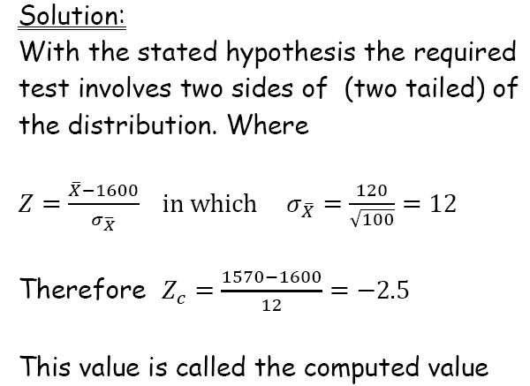
TEST OF HYPOTHESIS

Slide 25

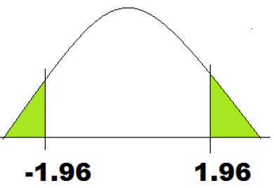
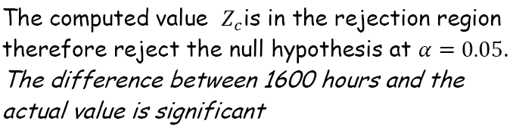
TEST OF HYPOTHESIS

Slide 26
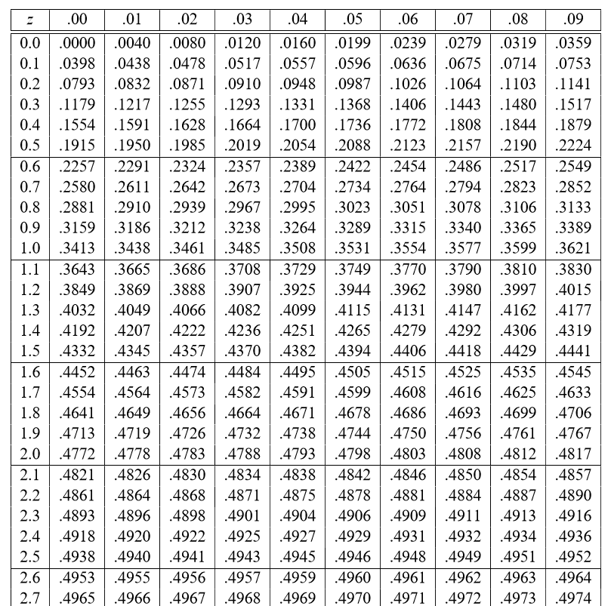
TEST OF HYPOTHESIS

Slide 27
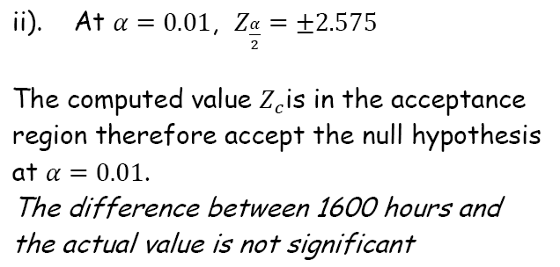
TEST OF HYPOTHESIS

Slide 28
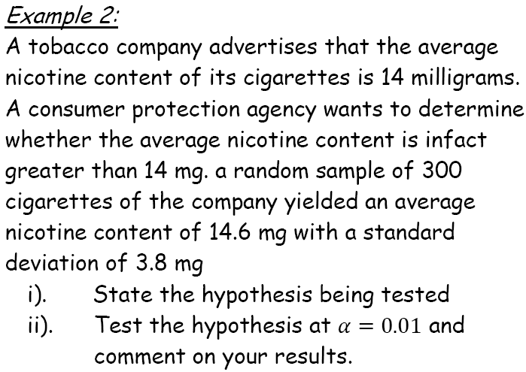
TEST OF HYPOTHESIS

Slide 29
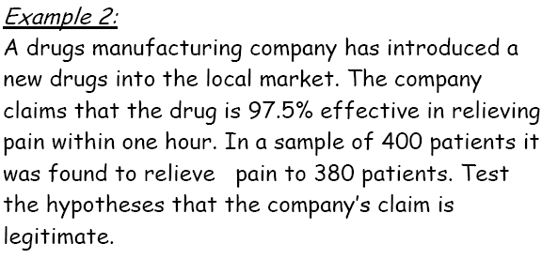
TEST OF HYPOTHESIS

Slide 30
TEST OF HYPOTHESIS
Solution ???

Slide 31
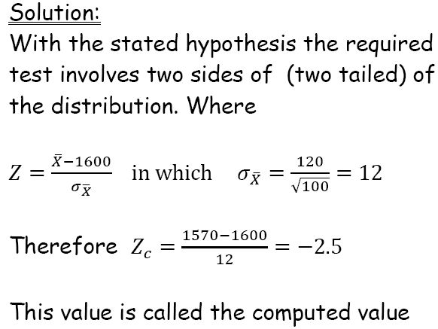
TEST OF HYPOTHESIS

Slide 32

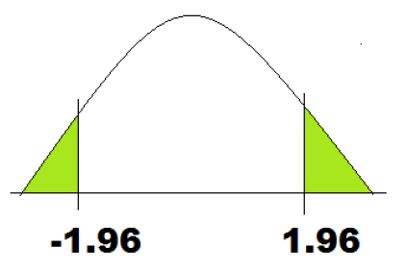
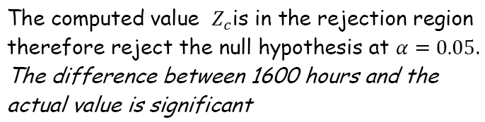
TEST OF HYPOTHESIS

Slide 33
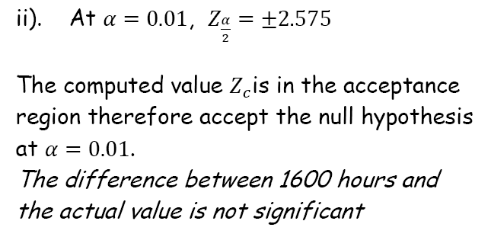
TEST OF HYPOTHESIS

Slide 34
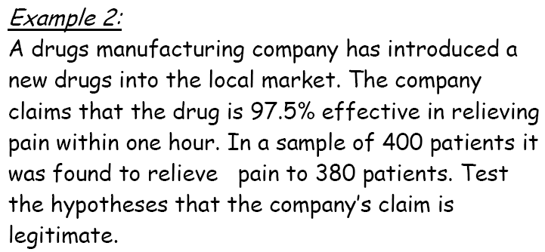
TEST OF HYPOTHESIS

Slide 35
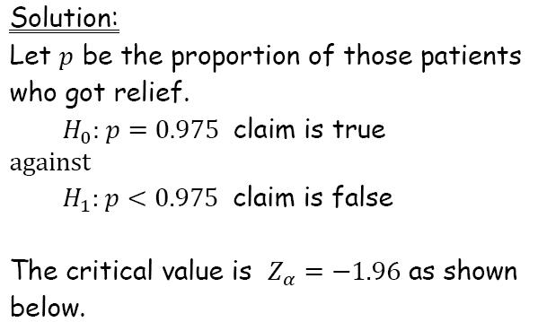
TEST OF HYPOTHESIS

Slide 36
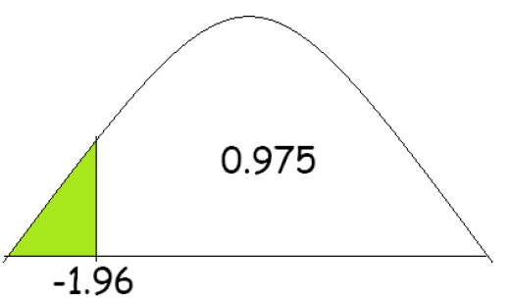

TEST OF HYPOTHESIS

Slide 37
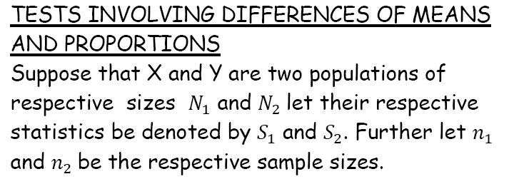

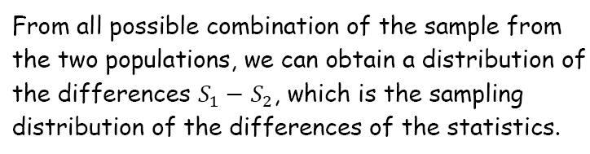
TEST OF HYPOTHESIS

Slide 38
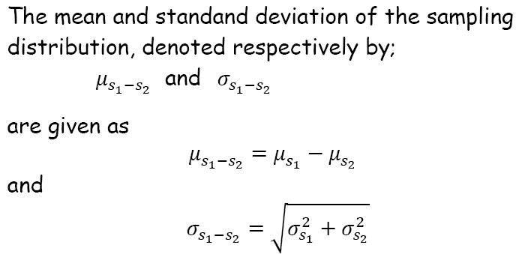
TEST OF HYPOTHESIS

Slide 39
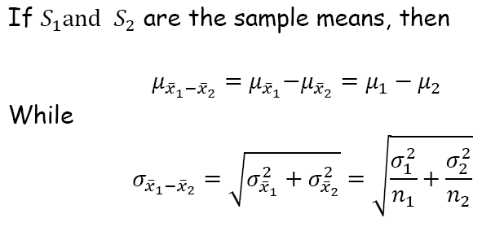
TEST OF HYPOTHESIS

Slide 40
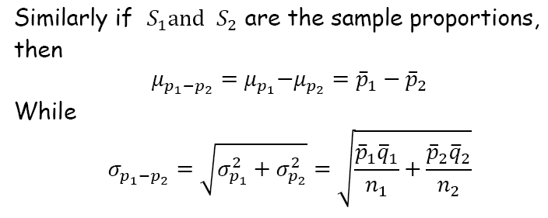
TEST OF HYPOTHESIS

Slide 41
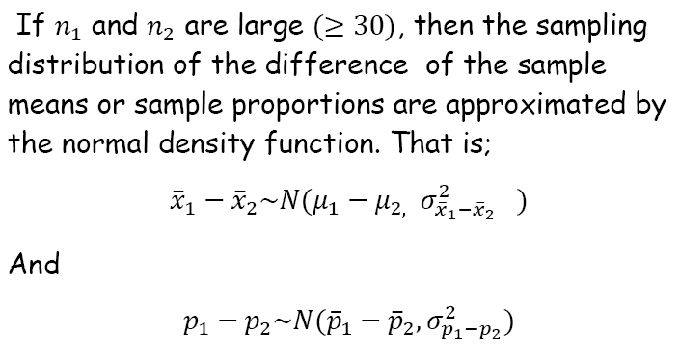
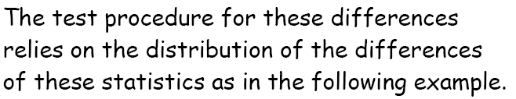
TEST OF HYPOTHESIS

Slide 42
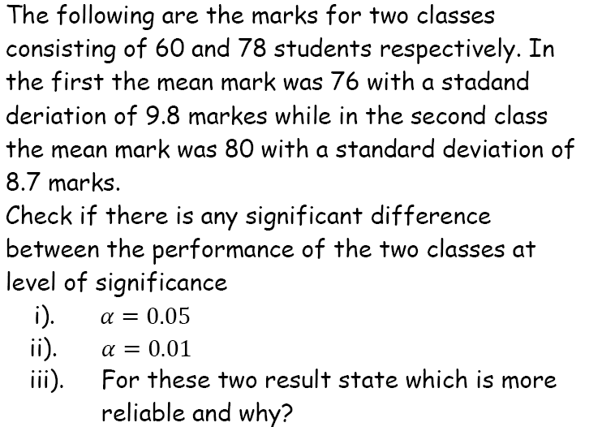
TEST OF HYPOTHESIS

Slide 43
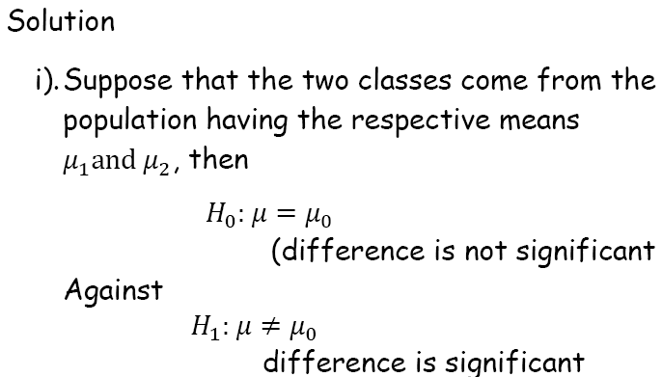
TEST OF HYPOTHESIS

Slide 44
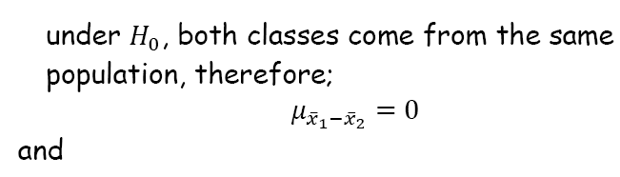
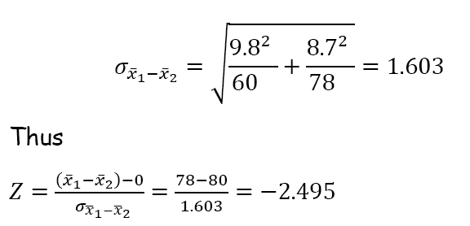
TEST OF HYPOTHESIS

Slide 45
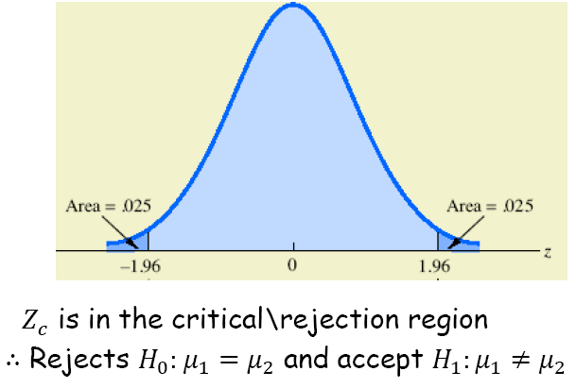

TEST OF HYPOTHESIS

Slide 46
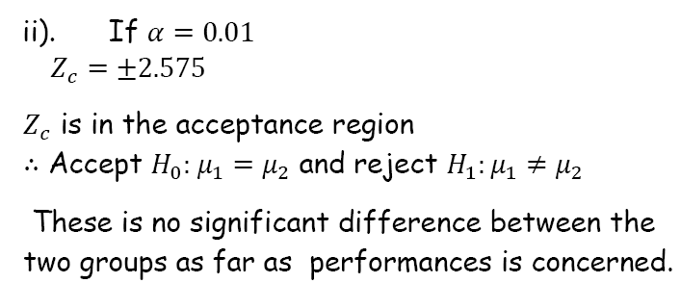
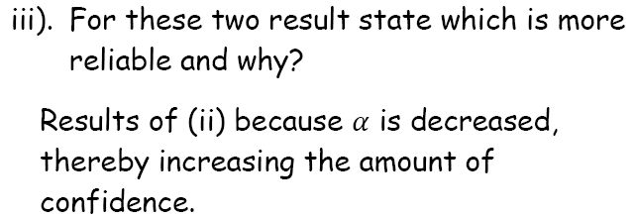
TEST OF HYPOTHESIS

Slide 47
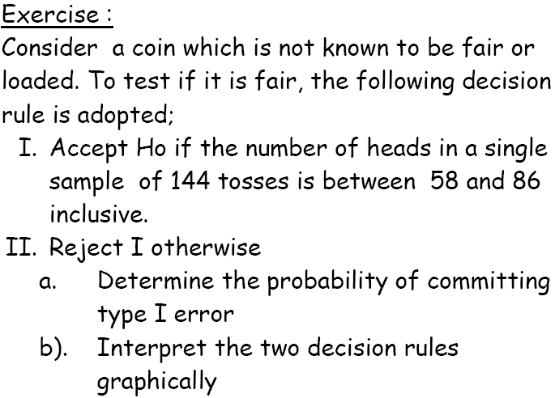
TEST OF HYPOTHESIS

Slide 48

TEST OF HYPOTHESIS

Slide 49
TEST OF HYPOTHESIS
Small sample test -means
student –t

Slide 50

t-TEST

Slide 51


t-TEST

Slide 52


t-TEST

Slide 53

t-TEST

Slide 54

t-TEST

Slide 55


t-TEST

Slide 56

t-TEST

Slide 57
t-TEST
Solution ????

Slide 58

t-TEST

Slide 59

t-TEST

Slide 60





t-TEST

Slide 61

t-TEST

Slide 62


t-TEST

Slide 63



t-TEST

Slide 64

t-TEST

Slide 65

t-TEST

Slide 66


t-TEST

Slide 67


t-TEST

Slide 68

t-TEST

Slide 69
t-TEST
Solution ????

Slide 70
12:10:16 PM
END OF LECTURE 8

